Slide 1


Reading the Tea Leaves
2025 Predictions
1001 BANNOCK STREET #424 | DENVER, CO 80204 | 303.872.7932 | CONTACT@JANUARYSPRING.COM

Slide 2

The Future of Local Media
5280 Magazine

Slide 3

Learnings From 2024
THE OLD WAY OF BUSINESS WILL BE LESS EFFECTIVE IN THE NEW YEAR
ANNUAL CONTRACT SEASON MAKES OR BREAKS Q1
THE GOOD SALESPEOPLE HAVE JOBS
Business owners and Marketing Managers sat on their 2024 budgets well into Feb.
2025, we are already seeing more annual contracts closing and the Jan/Feb contract volume looking more stable.
If you are hiring, you have to go after passive job seekers. The ones actively looking, aren’t the ones you want.
NICHE MEDIA PROVED ITS WORTH
The October surprise of the 2024 election was Niche Media’s ability to directly connect with its audience and influence voters.
FIRST PARTY DATA GOLD
If you aren’t building your own first-party data strategy, you will become less valuable to your ad clients over time
1001 BANNOCK STREET #424 | DENVER, CO 80204 | 303.872.7932 | CONTACT@JANUARYSPRING.COM

Slide 4

Digital- First Selling
(2025 is the tipping year for traditional media)
Account-Based Marketing (generic targeting doesn’t produce ROI)
Hybrid Sales Reps
(not where they work, but how they work)
Brace for More Change
(break up of Google?)
2025 TO-DO LIST
Publishers have all the tools necessary to win in 2025. The focus on HOW you sell. Sales culture, discipline, and accountability will make you a winner.
1001 BANNOCK STREET #424 | DENVER, CO 80204 | 303.872.7932 | CONTACT@JANUARYSPRING.COM

Slide 5
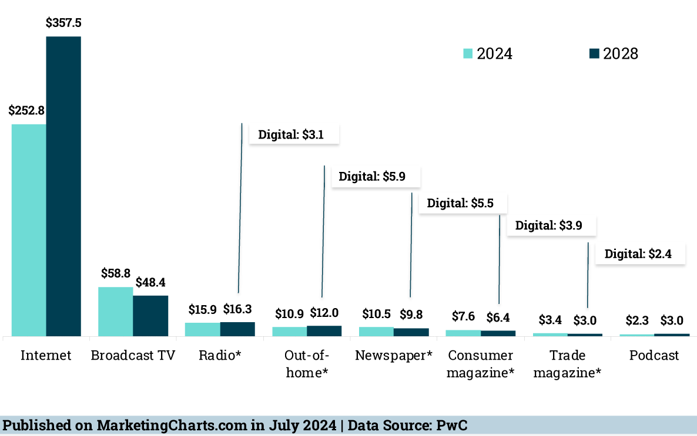
Grow Your Advertiser Base
YOUR ADVERTISER BASE WILL CONTINUE TO SHRINK WITHOUT DIGITAL
US Advertising Media Market Size ($B) 2024 vs 2028
Digital Dominance:
Traditional advertising channels are not growing at the same pace as digital channels.
Source: PwC

Slide 6
Digital First Selling
TO RETAIN YOUR PRINT, YOU’LL NEED TO
LEAD WITH DIGITAL
Programmatic growth in 2024 came from incremental digital spending more than the cannibalization of traditional ad spending, which is flat.
That’s set to change:
In 2025 and 2026, $9.56 billion will migrate to digital from traditional ad spending.
No more a la carte, product selling.
Sell multi-media programs through pre-packaged offerings based on the category & outcome wanted by the Advertiser.
Source: eMarketer
1001 BANNOCK STREET #424 | DENVER, CO 80204 | 303.872.7932 | CONTACT@JANUARYSPRING.COM

Slide 7
Digital advertising will surpass
80% share of total ad spend
in 2025.
Source: eMarketer Oct 2024
1001 BANNOCK STREET #424 | DENVER, CO 80204 | 303.872.7932 | CONTACT@JANUARYSPRING.COM

Slide 8
Realign Your Sales Approach to Help Advertisers
Reach Their Target Buyer
SOLUTION SELLING, NOT PRODUCT SELLING
CURRENT MARKETING
RECOMMENDED MARKETING
JEWLERY
ADVERTISER
50% of budget allocated to PRINT
25% allocated to digital display, social
25% allocated to pd search
25% allocated to PRINT
75% to search, digital display, social
With an emphasis on video and product content marketing
FURNITURE
ADVERTISER
40% of budget allocated to Broadcast
30% allocated to PRINT
30% allocated to digital display, social
20% allocated PRINT
40% to targeted, streaming TV
30% to digital display, social
10% to targeted eBlasts
1001 BANNOCK STREET #424 | DENVER, CO 80204 | 303.872.7932 | CONTACT@JANUARYSPRING.COM

Slide 9
US B2B companies will spend 14.9% more YoY
on digital advertising in 2025
Compared to last year's 9.3% growth.
Source: eMarketer Nov 2024
1001 BANNOCK STREET #424 | DENVER, CO 80204 | 303.872.7932 | CONTACT@JANUARYSPRING.COM

Slide 10
Account
Based
Marketing
What is ABM?
Account Based Marketing (ABM) focuses on identifying and targeting high-value accounts rather than a broad audience.
Digital channels offer advanced targeting capabilities, allowing businesses to reach specific segments of their audience with tailored messages.
Customized campaigns for each target account. These campaigns are tailored to address the unique needs and challenges of the target company, making them more relevant and effective.
HYPER TARGETED
Campaigns based on a known number of target buyers.
Full-funnel advertising to attract, persuade, and close.
Targeted ad messaging that speaks to a need.
Measure, Optimize….Rinse, Repeat
1001 BANNOCK STREET #424 | DENVER, CO 80204 | 303.872.7932 | CONTACT@JANUARYSPRING.COM

Slide 11



Eat Your Own Dog Food
MARKET YOUR ADVERTISING PROGRAM TO POTENTIAL BUYERS
https://reports.live/shared/yW1gQ5N1l78dbAjp
1001 BANNOCK STREET #424 | DENVER, CO 80204 | 303.872.7932 | CONTACT@JANUARYSPRING.COM

Slide 12
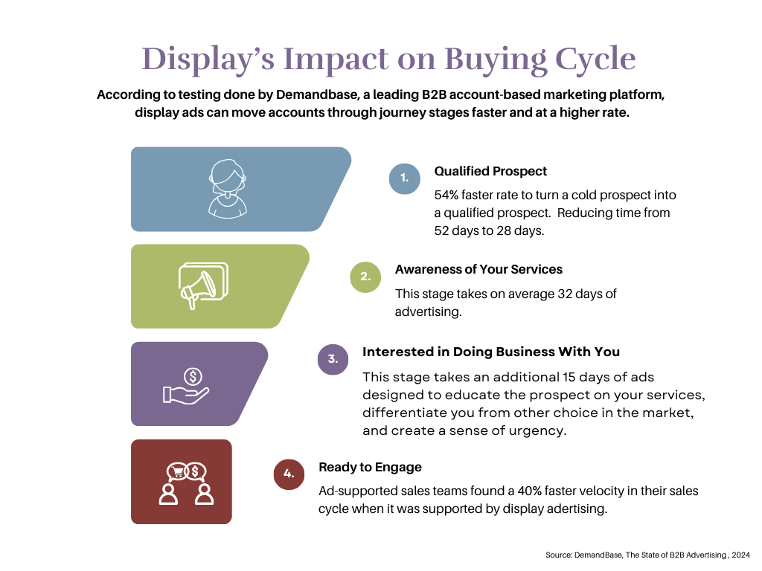

Slide 13
Decrease Your Sales Cycle
ADVERTISE TO YOUR PROSPECTS
THE WINNING COMBINATION: DISPLAY, SOCIAL, STREAMING TV,
SEARCH.
Running streaming TV and display campaigns together for your own, campaigns could result in a 46% increase in traffic to your website and 54% increase on clicks to your ads.
Source: DemandBase
1001 BANNOCK STREET #424 | DENVER, CO 80204 | 303.872.7932 | CONTACT@JANUARYSPRING.COM

Slide 14
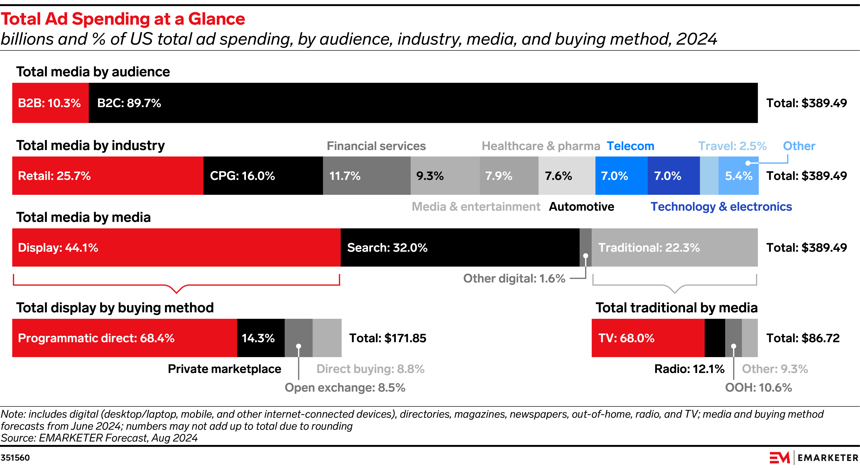

Slide 15
https://go.forrester.com/wp-content/uploads/2023/10/Forrester-Predictions-2024.pdf
Sales Culture: Rise of the Hybrid Rep
NOT HYBRID WORK; HYBRID SELLING
SERVICE ACCOUNTS THE WAY THEY WANT TO BE SERVICED
Reps must learn to toggle between face-to-face and remote and Zoom/Teams calls.
Managers must realize that text and email are accepted forms of communication.
No more product-focused sellers, hybrid reps must create tailored offerings that suit their customers’ particular needs.
By 2025, the average B2B buyer will be a Millennial.
80% of sales interactions will be entirely digital
44% prefer no sales rep
Source: Forrester

Slide 16
https://www.hubspot.com/hubfs/HubSpots%202024%20Sales%20Trends%20Report.pdf Nov 2024
Sales Culture: Rise of the Hybrid Rep
NOT HYBRID WORK; HYBRID SELLING
MORE DECISION MAKERS TO PLEASE
As the media buying decisions move from Boomers to Millennials, expect more decision makers to be in the mix.
According to Hubspot, 33% of sales reps agree the number of decision-makers involved in the sales process increased in 2023. And got worse in 2024.
72% of company revenue comes from existing customers, with 28% coming from new customers. The average sales win rate is 21%.
      There’s an average of 5 decision-makers
      involved in every sales process today.
Source: HubSpot

Slide 17



Sales Culture: Rise of the Hybrid Rep
NOT HYBRID WORK; HYBRID SELLING
Let simple, product sale transactions be self-serve with a hybrid salesperson servicing and growing that account.
Think EVERGREEN!
More complex, custom long-term campaigns to go through the sales team.
You need a self-serve sales channel as part of your hybrid selling model.
Source: Gartner
1001 BANNOCK STREET #424 | DENVER, CO 80204 | 303.872.7932 | CONTACT@JANUARYSPRING.COM

Slide 18
More Changes Ahead
DOJ’s SUITS AGAINST GOOGLE
64% OF ADVERTISING GOES TO THESE CHANNELS
Potential outcomes include:
Sell off its Chrome browser. 60% of browser market.
$49B in search revenue at stake.
Divestment Android mobile operating system.
Prohibited from favoring its video subsidiary, YouTube. Worth $31B in ad revenue.
Terminate revenue-sharing agreements, including with Apple for Chrome promotion.
Syndicate Google’s search feed, giving competitors access to all their first party data.
Google
Facebook
Amazon
Sources: Statista,
Digiday, Yahoo Finance
1001 BANNOCK STREET #424 | DENVER, CO 80204 | 303.872.7932 | CONTACT@JANUARYSPRING.COM

Slide 19
1001 BANNOCK STREET #424 | DENVER, CO 80204 | 303.872.7932 | CONTACT@JANUARYSPRING.COM

